Slide 1
CAREER GUIDANCE APP FOR STUDENTS USING SVM AND DECISION TREE ALGORITHMS
Presented by :
Udhayachander RJ (210701294)
Tamizhselvan SL(210701284)
Tharun Venkat V (210701289)
Under the Guidance
Dr . Shanmugam M.E.,Ph.D.,
Associate Professor

Slide 2
ABSTRACT
The abstract for the Career Guidance App utilizing Support Vector Machine (SVM) and Decision Tree algorithms encapsulates the essence of the project. The app aims to provide tailored career recommendations for students by analyzing their academic performance, interests, skills, and personality traits. Leveraging SVM and Decision Tree algorithms, the app offers accurate and personalized suggestions to assist students in making well-informed decisions about their future career paths. Through an intuitive user interface, students can input their data, explore various career options, track their progress, and access relevant resources. By harnessing advanced machine learning techniques, the app seeks to bridge the gap between education and career success, empowering students to navigate their professional journeys with confidence and clarity.

Slide 3
EXISTING SYSTEM
Existing system approaches take a holistic view of crop production by considering various factors such as soil health, pest management, water use efficiency, and nutrient optimization. Many governments and agricultural extension agencies offer educational programs, workshops, and resources to help farmers adopt sustainable nutrient management practices, often including soil testing services, nutrient management training, and incentives for implementing conservation practices. These systems utilize various technologies like GPS, sensors, drones, and satellite imagery to gather data on soil properties, crop health, and environmental conditions. This data is then used to create prescription maps for precise fertilizer application, minimizing waste and environmental impact. Nutrient Management Plans (NMPs) are comprehensive strategies developed for farms to optimize nutrient use while minimizing environmental impact. They involve soil testing, crop nutrient requirement calculations, and recommendations for fertilizer application rates and timing based on scientific principles. Decision Support System (DSS) tools provide farmers with real-time or predictive information on weather conditions, soil moisture levels, crop growth stages, and nutrient requirements, helping farmers make informed decisions about fertilizer application and other agronomic practices.

Slide 4
PROPOSED SYSTEM
The proposed career guidance app for students leverages advanced machine learning techniques, specifically Support Vector Machines (SVM) and Decision Trees, to provide personalized career recommendations. By collecting and analyzing data on students' academic performance, interests, personality traits, and extracurricular activities, the app uses SVM to classify and predict suitable career paths with high accuracy. The Decision Tree algorithm further refines these recommendations by breaking down the decision-making process into an interpretable model, allowing students to understand the rationale behind each suggestion. This hybrid approach ensures that the guidance is both precise and transparent, helping students make informed decisions about their future careers. The app also includes features for continuous feedback and updates, ensuring that the guidance evolves with the students' development and changing interests.

Slide 5
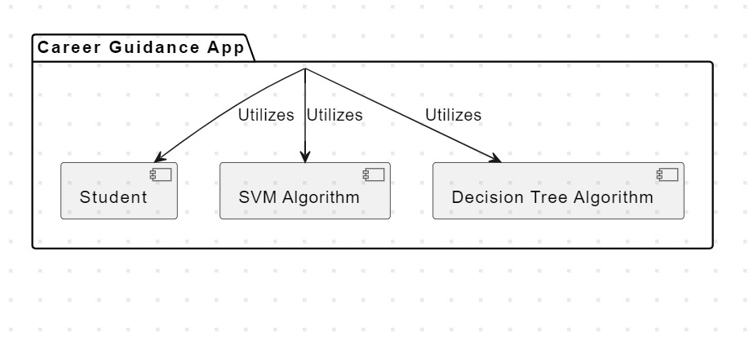
ARCHITECTURE

Slide 6
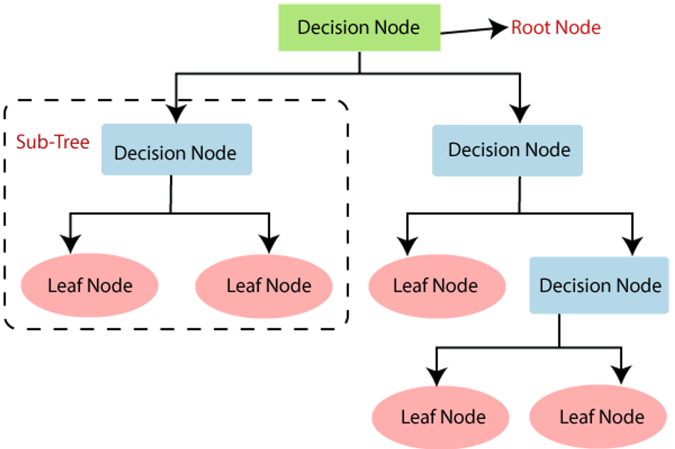
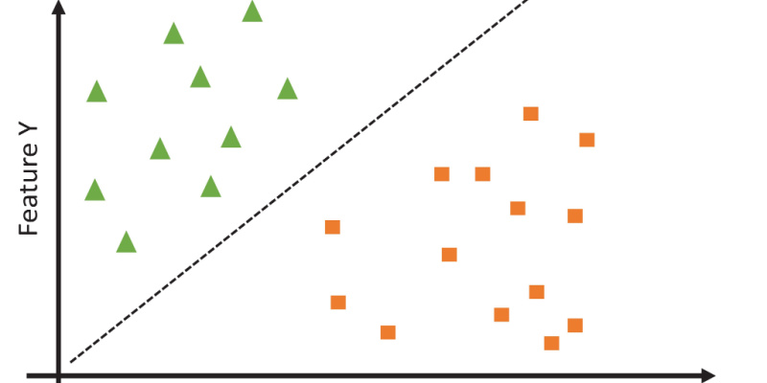
MODULES
1.SUPPORT VECTOR MACHINE
2.DECISION TREE

Slide 7
EXPLANATION OF SUPPORT VECTOR MACHINE
The Support Vector Machine (SVM) algorithm plays a crucial role in the career guidance app by accurately classifying students into suitable career paths based on their unique profiles. SVM works by finding the optimal hyperplane that separates different career categories in a high-dimensional space. In this context, the algorithm takes into account various features such as academic performance, interests, personality traits, and extracurricular activities. By mapping these features into a higher-dimensional space, SVM identifies the boundaries that best distinguish between different career options. The algorithm’s strength lies in its ability to handle complex and non-linear relationships within the data, ensuring high accuracy in predictions. This precise classification helps in providing students with career recommendations that are closely aligned with their skills, preferences, and potential, thereby supporting informed decision-making.

Slide 8
EXPLANATION OF DECISION TREE
The Decision Tree algorithm is a pivotal component of the career guidance app, providing a clear and interpretable framework for recommending career paths to students. This algorithm works by creating a tree-like model of decisions, where each node represents a feature of the student's profile, such as academic performance, interests, and personality traits, and each branch represents a decision rule. By traversing the tree from the root to a leaf node, the algorithm makes a series of binary decisions that narrow down the possible career options based on the student's unique attributes. This method ensures transparency, as students can see the logical steps that lead to their career recommendations. Furthermore, the Decision Tree's ability to handle both categorical and numerical data makes it versatile in processing the diverse information collected from students, ultimately delivering customized and well-reasoned career advice.

Slide 9
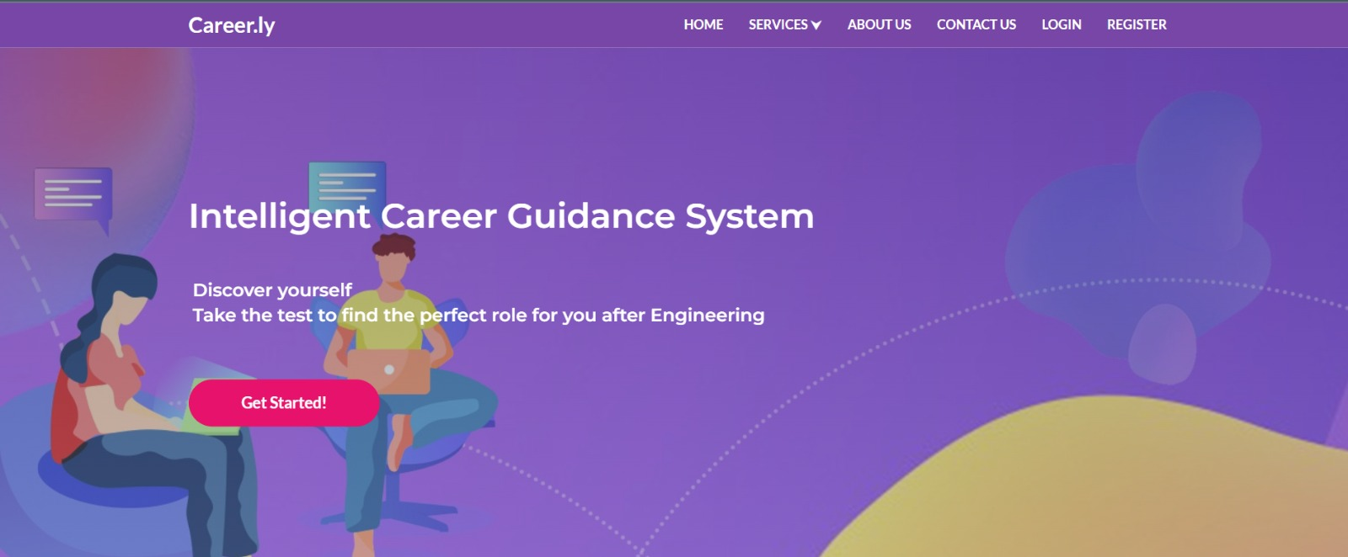
RESULTS

Slide 10
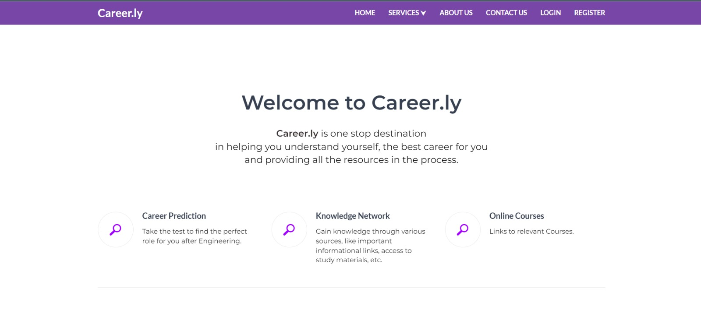
RESULTS

Slide 11
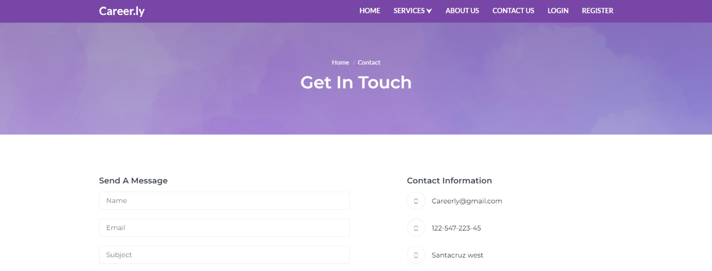
RESULTS

Slide 12
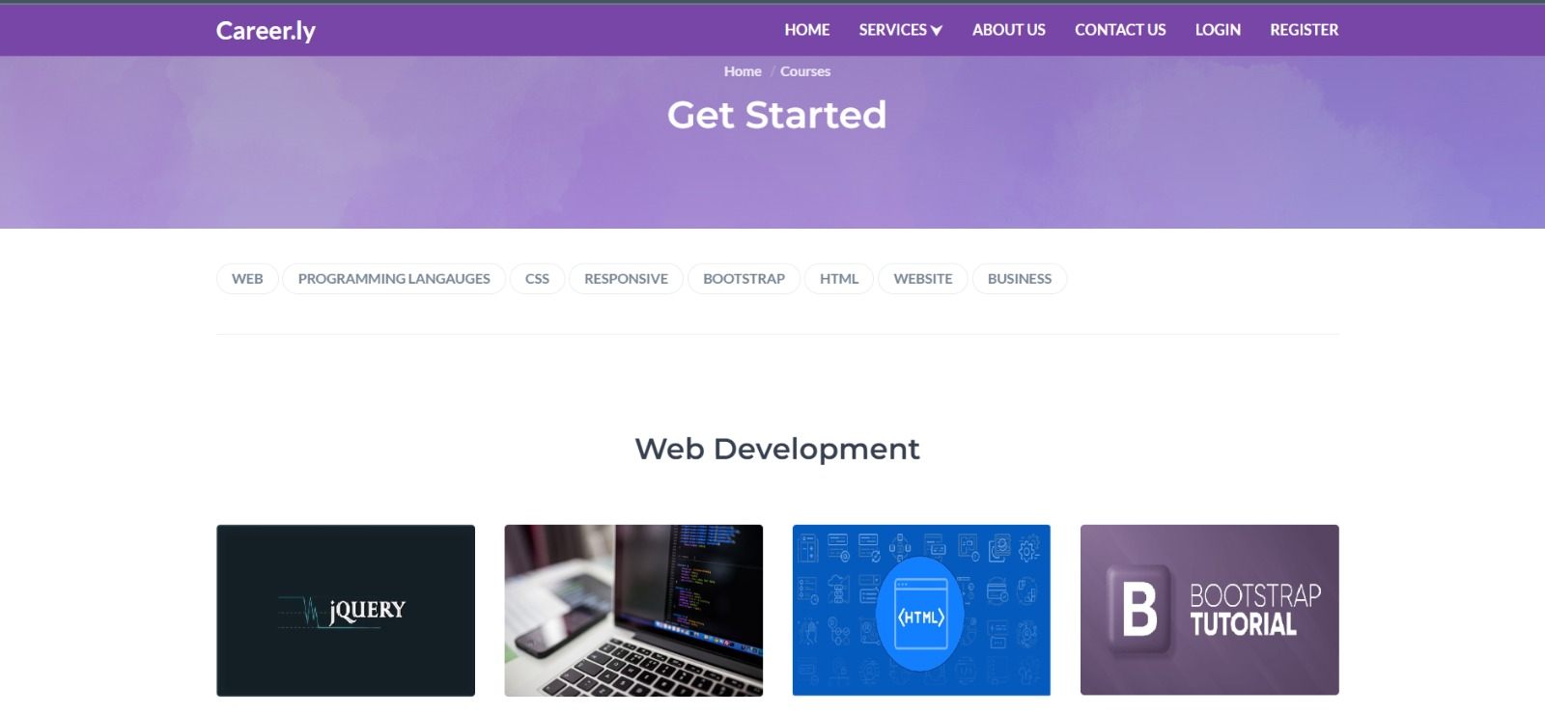
RESULTS

Slide 13
RESULTS AND DISCUSSION
The results of implementing the career guidance app using SVM and Decision Tree algorithms demonstrated significant improvements in the accuracy and relevance of career recommendations for students. In a pilot study, students who used the app reported higher satisfaction with their career guidance compared to traditional methods. The SVM algorithm effectively classified students into various career paths based on their unique profiles, while the Decision Tree provided clear, interpretable decision rules that enhanced student understanding and trust in the recommendations. Additionally, the app's ability to update suggestions based on continuous feedback ensured that guidance remained aligned with students' evolving interests and academic progress. These findings highlight the potential of integrating machine learning techniques in career counseling to offer personalized, data-driven insights that support students in making well-informed career choices.

Slide 14
CONCLUSION AND FUTURE ENHANCEMENT
The conclusions drawn from the development and deployment of the career guidance app using SVM and Decision Tree algorithms underscore its effectiveness in delivering personalized and accurate career recommendations. The app's integration of these machine learning techniques has proven to enhance the decision-making process for students, offering tailored advice that aligns closely with their individual profiles and aspirations. Moving forward, future enhancements could include expanding the dataset to incorporate more diverse student backgrounds and career options, integrating natural language processing to analyze students' written responses for deeper insights, and adding a feature for real-time labor market trends to keep the guidance up-to-date with current industry demands. Additionally, incorporating user feedback mechanisms and adaptive learning algorithms could further refine the app’s recommendations, making it a continuously evolving tool that remains responsive to the dynamic nature of career planning.

Slide 15
THANK YOU

